Slide 1
SMART COMPUTER IN VEHICLE
Submitted by,
R.Jayachandran.

Slide 2
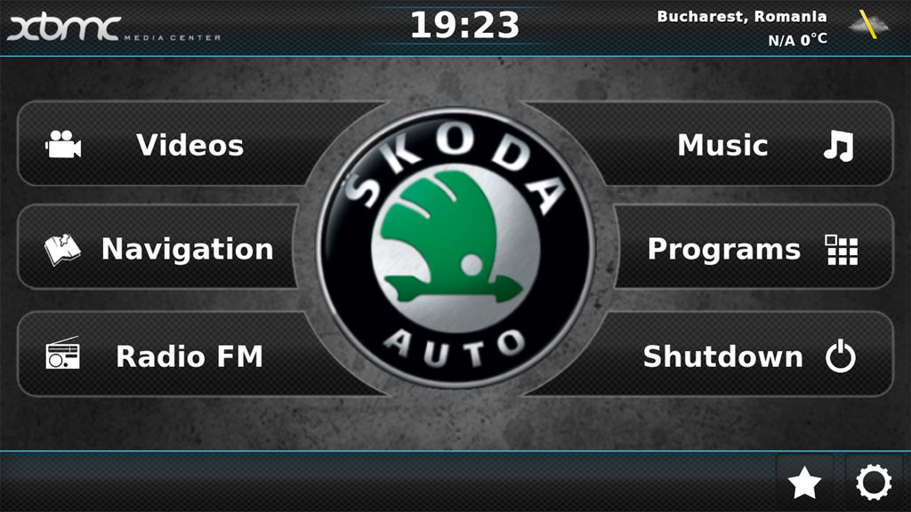
A BACK TO HISTORY An Intro says Development and an existing too right?
Computerized automotive systems are an ongoing evolution, Now a days Carputer system which is installed and run in cars.
They looks as smartphones and PDAs Which become more powerful, and have included useful technologies.
They are not a smart technology.
Problem A lot to state:
Limited Usage with high cost.
Not Reliable.
Need more power .
Not Efficient and easy.

Slide 3
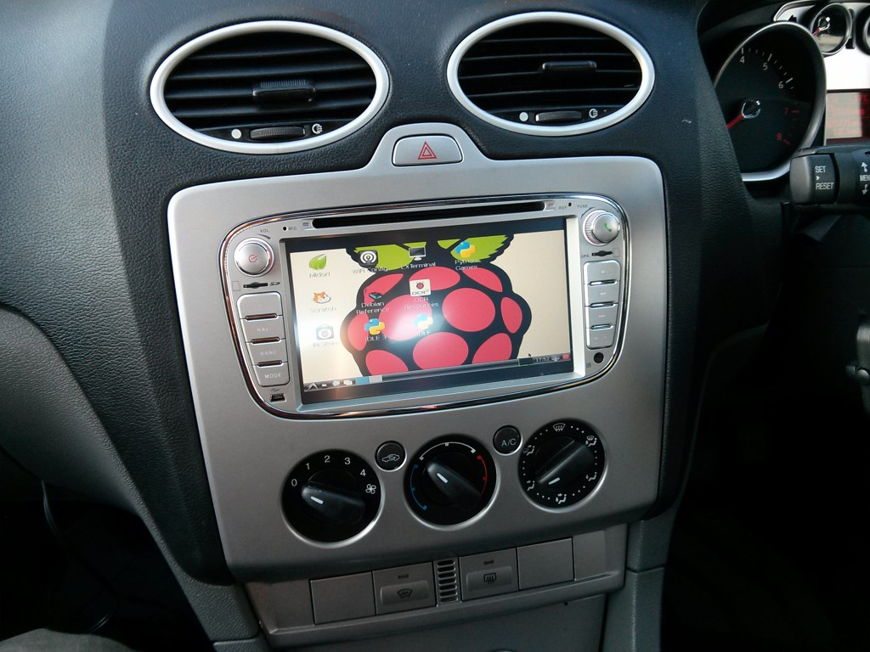
Proposed Technology
We Introduce the enhancement carputer with simple and cost efficient system using Raspberry Pi .
To simple we say “MINI computer in car”.
It includes all working nature of a PC such as peripheral Installation, Graphics, RAM, Secondary Storage, Video and Audio Output.
So this system is cost efficient and too simple.

Slide 4
Literature survey
ADVANCED VEHICLE MONITORING AND TRACKING SYSTEM BASED ON RASPBERRY PI
To provide safety environment to the traveller through GSM ,GPS and GPRS.
GPS-It gives current location to the driver and also helps to return location information during the time of theft.
GPRS-It sends tracking information to the driver.
GSM-It is used for sending alert message to the vehicles owner mobile.

Slide 5
LITERATURE SURVEY(cont.)
Raspberry –pi based cost effective vehicle collision avoidance system using image processing
Edge detection Algorithm
Laplacian edge detection
Sobel edge detection
Canny edge detection

Slide 6
LITERATURE SURVEY(cont.)
DESIGN AND IMPLEMENTATION OF AUTONOMOUS CAR USING RASPBERRY PI
Lane detection and obstacle detection are combined together to provide necessary control to the car.
Lane detection algorithm
Remotely controlled car
Car with autonomous obstacle avoidance
Car with autonomous navigation

Slide 7
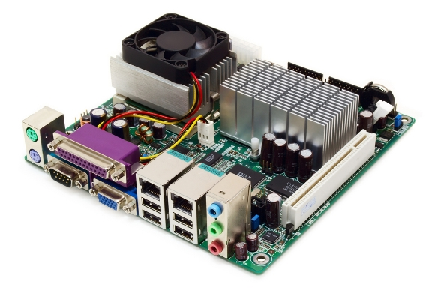
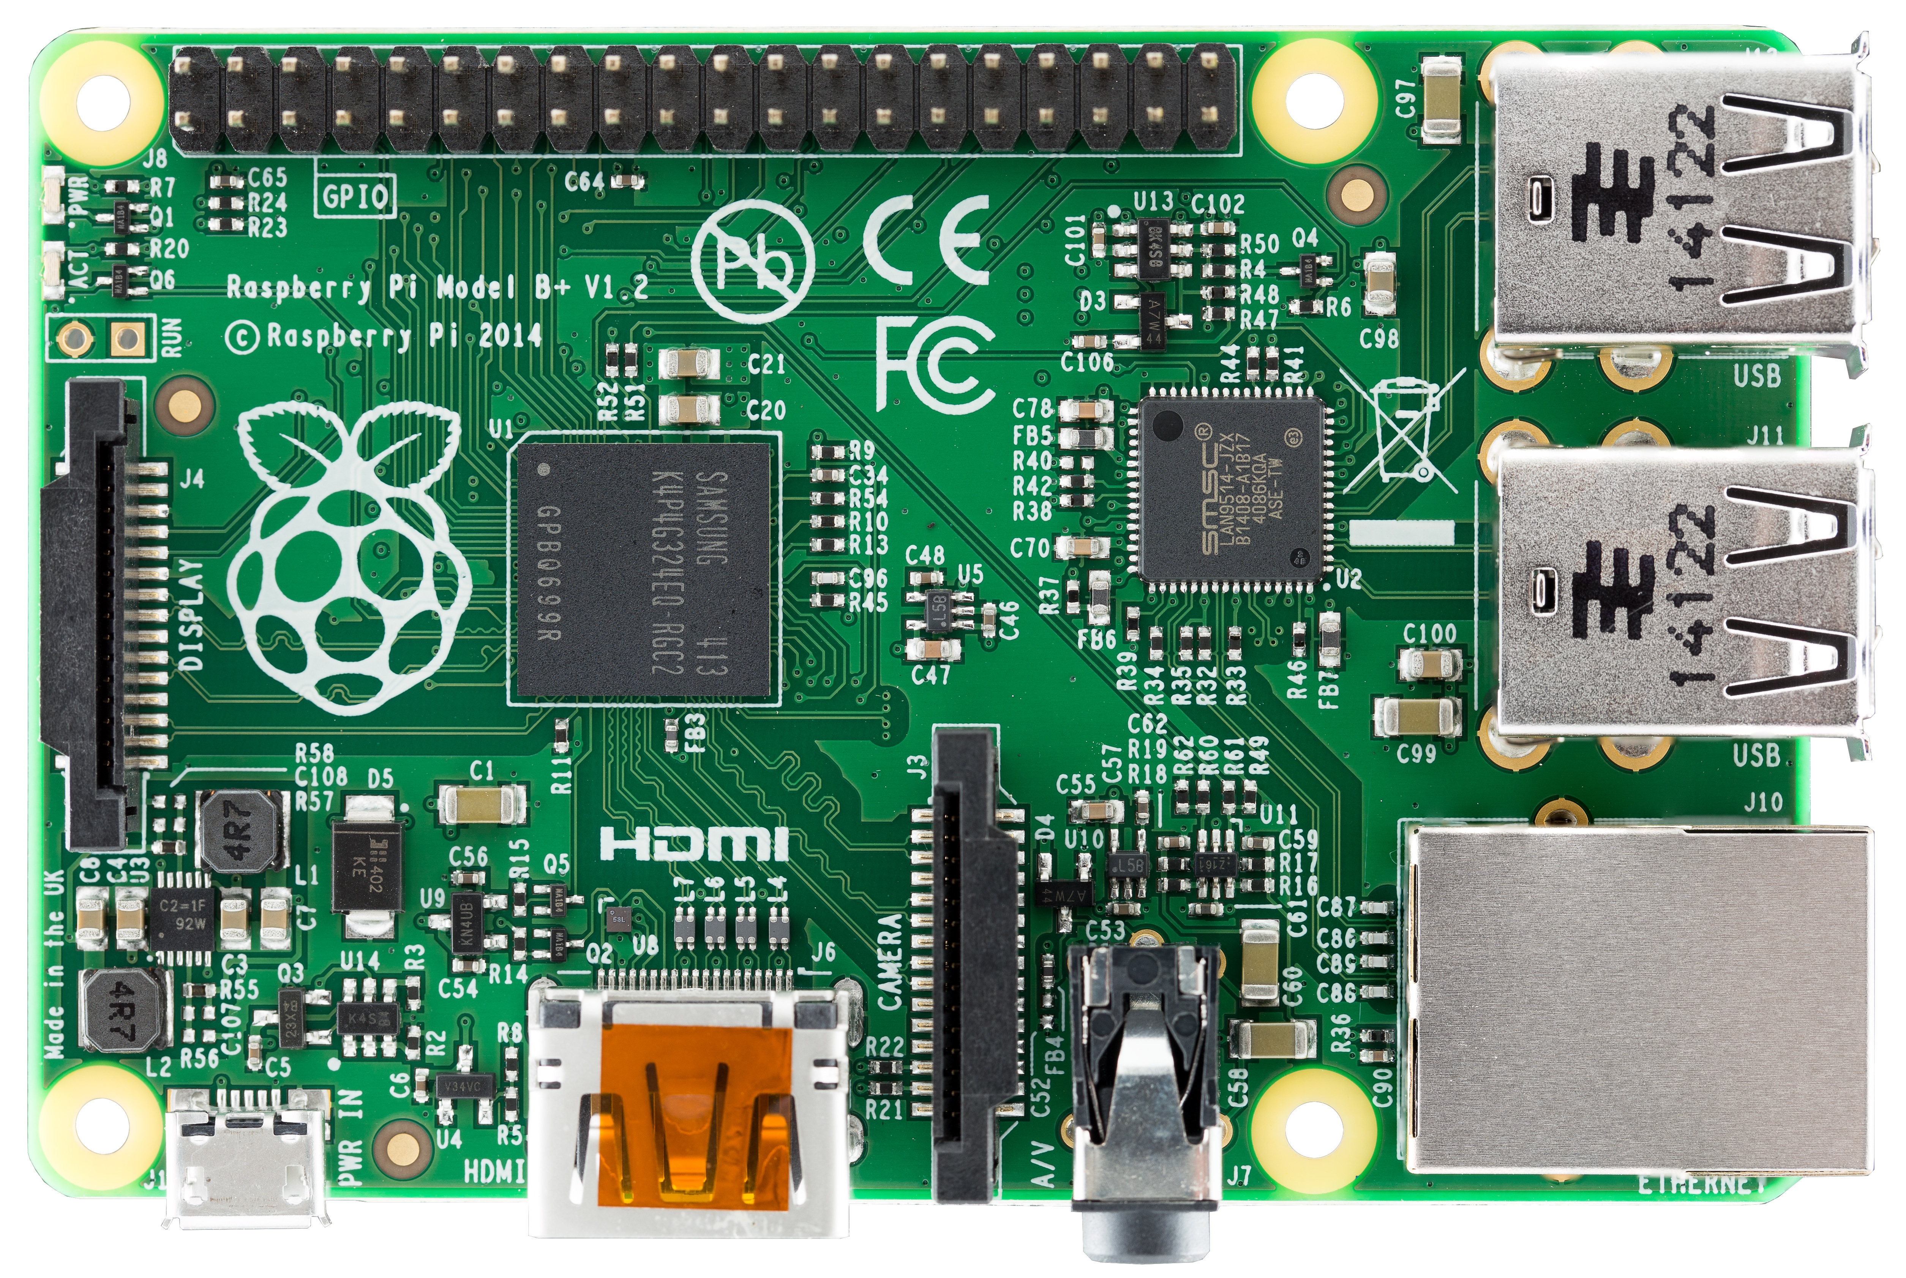
WHY RASPBERRY PI? A piece of art is a compact form of the universe
PC Board
Raspberry pi
PICTURE SIZE SAYS.
Compact.
Same working as pc.
Additional sensors can be integrated.
Consumes less power.
HDMI output.
LAN adapter is also present.
Bigger in Size.
No sensors can be added.
Consumes a lot power.
Cannot support miniature environment.

Slide 8
WHAT WE DO WITH RPI? Changes bring Opportunity.
Raspberry Pi, is somewhat equivalent to the chip used in PC’s which include as the facilities of carputer.
So by overcoming the disadvantages of present technology above by replacing this new one into a vehicle.
By using this different tasks can be performed on same circuit:
Music, Videos and Entertainment through interface of keyboard and mouse.
Usb camera can be integrated. Since its cost efficient than the present.
Security system Is to be implemented by using Vibration sensor.

Slide 9
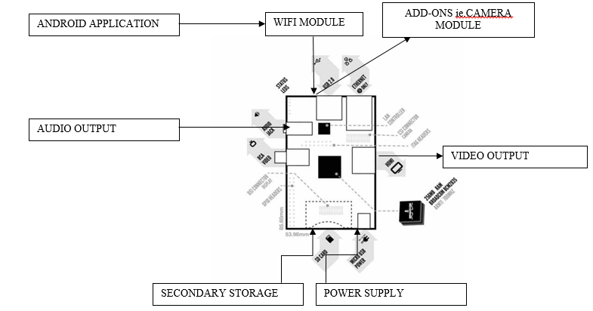
SYSTEM ARCHITECTURE

Slide 10
MODULES A Brief
WIFI MODULE(communicate with RPI).
VIBRATOR MODULE(security).
GSM MODULE(monitoring mechanism).
CAMERA MODULE(sensor).

Slide 11
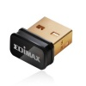
WIFI MODULE(COMMUNICATING WITH RPI)
Using this wifi module the GPIO pins can be controlled by means of mobile application (android).
So that the Sensors can be activated and deactivated simultaneously.
FEATURES:
Ranges upto 25 ms.
SSID Secured.
Can Activate sensors.
ADVANTAGES:
Low Power Wakeup Switch
Low Cost for interface.
Can share files.
SECURITY will be question right?

Slide 12
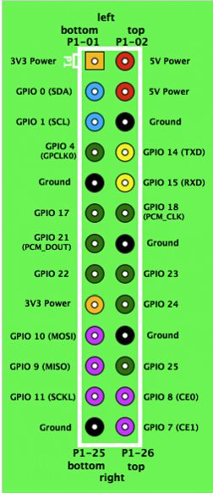
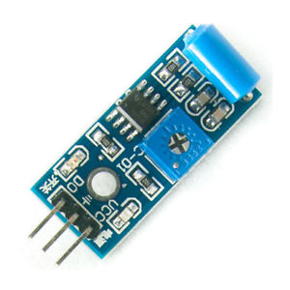
VIBRATOR SENSOR
-By connecting sensor to the GPIO pins and access by means of WIFI.
-The minimal vibration is acquired from the vehicle during theft and beep is noticed.
FEATURES:
Standard grove socket
Wide dynamic range：0.1Hz~180Hz
Adjustable sensitivity
High receptivity for strong impact
ADVANTAGES:
Low Power Wakeup Switch
Low Cost Vibration Sensing
Car Alarms
Body Movement

Slide 13
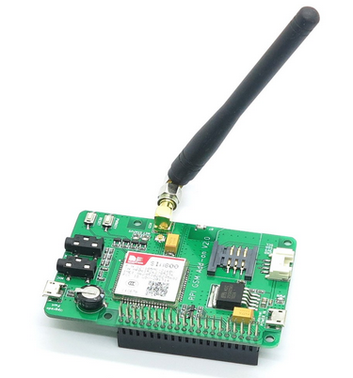
GSM module
It is a digital cellular technology used for transmitting mobile voice and data services.
GSM also make sure that all the communication made between networks are secured and protected from intruders and frauds.
It is to help the non android users to alert the security system by sending a message.

Slide 14
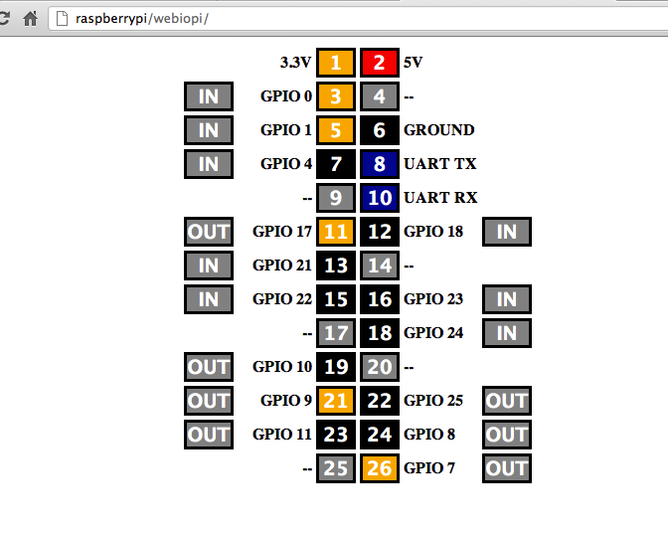
WEBiopi
It is a raspberry pi’s toolkit.
Control, debug and use pi’s GPIO, sensors and converters from a web browser or any app.

Slide 15
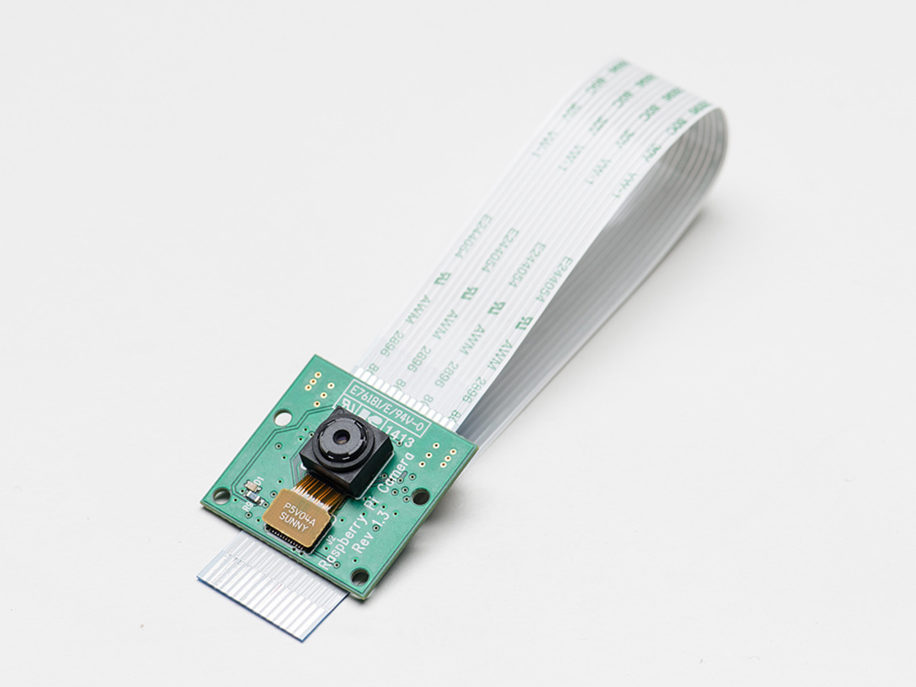
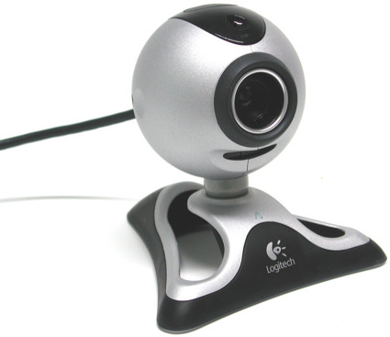
CAMERA MODULE(sensor)
-The usb camera connected to rear side of the vehicle.
-Smart parking system can be achieved by this module in simple and efficient method.
FEATURES:
5Mp of lens quality.
Video: 1080p at 30 fps with codec H.264 (AVC)
Up to 90 fps Video at VGA
Adjustable sensitivity
High receptivity for strong impact
ADVANTAGES:
Low Power Wakeup Switch
Low Cost compared to pri camera.
Rear camera with object detection.

Slide 16
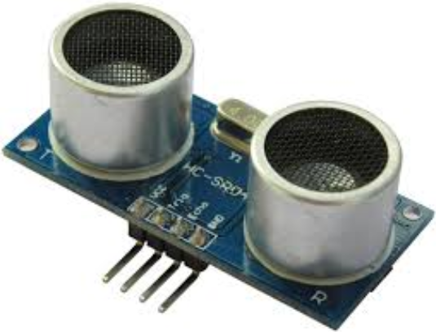
Ultrasonic sensor
Ultrasonic transducer converts ultrasound waves to electrical signals or vice versa.
The response of analog ultrasonic sensors is linear with distance. By interfacing the sensor to an LED display, it is possible to have a visual indication of target distance.

Slide 17
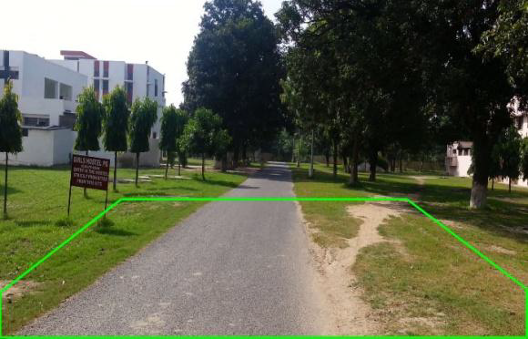
Lane detection
The USB camera connected to rear side of the vehicle.
Smart parking system can be achieved by this module in simple and efficient method.
Lane detection can be performed using the simple image
processing algorithms.

Slide 18
references
[01] Narayan Pandharinath Pawar & Minakshee M. Patil, “Driver Assistance System based on Raspberry Pi”, International Journal of Computer Applications (0975 – 8887) Volume 95– No.16, June 2014, pp. 36-39.
[02]Pritish Sachdeva and Shrutik Katchii,“A Review Paper on Raspberry Pi”,Vol.4, No.6,Dec 2014 GPIO pins-
[03] NEWS BRIEF, Published by the “IEEE Computer Society”, 0018-9162/12 © 2012
[04] Raspberry pi https://www.raspberrypi.org/documentation/usage/gpio-plus-and-raspi2/.
[05] http://raspi.tv/2014/rpi-gpio-quick-reference-updated-for-raspberry-pi-b
[06] GSM- http://ubuntuguide.org/wiki/Ubuntu_Oneiric_Maps_and_GPS
[07] Eben Upton,Gareth Halfacree, “Raspberry Pi User Guide manual” 2012.

Slide 19
THANK YOU

